Slide 1
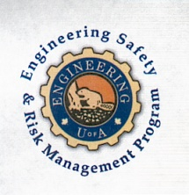
Fundamentals of RM
RM System and Process
Leadership in RM
Incident Investigation
RM Tools & Challenges
RM in Industry
People & Org.
Application and Perspectives
On Becoming a Leader in Safety and Risk Management
ENGG404 Lecture
Chapter 3.1 The Risk Management Program
Chapter 3.2 The Risk Management Work Process
Chapter 3.3 The Risk Management System and Elements (Part 1)
1
Notes:
ENGG404 Lecture 00 - Day 1
1
1

Slide 2
Learning Outcomes:
Explain how a risk management program is structured.
Apply each of the steps in a risk management work process.
Explain the risk management system elements
Differentiate between risk management system elements.
Chapters 3.1, 3.2, and 3.3

Slide 3
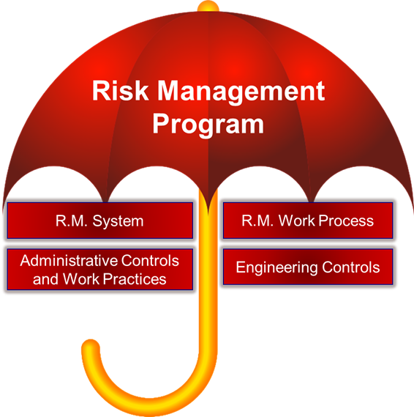
The Risk Management Program - the “Umbrella”:
Overarching program to:
Assess and reduce risk
Manage residual risk
Made up of 4 areas:
RM Work Process
RM System and Elements
Administrative Controls and Work Practices
Engineering Controls
Chapter 3.1 The Risk Management Program
3
Notes:
3

Slide 4
The Risk Management Work Process:
Let’s examine Chapter 3.2: The Risk Management Work Process:
Chapter 3.2: The Risk Management Work Process
4
Notes:
4

Slide 5
The Risk Management Work Process:
What is a Risk Management Work Process?
One part of an overall risk management program
First analyzes risk to PEAP
What are the chances of it happening? Likelihood
How bad could it be? Consequence
Then systematically assesses that risk against what is acceptable in order to:
Reduce risk to PEAP
Utilizing tools such as:
Risk Matrices
Risk Criteria Tables
Management Directions
Chapter 3.2: The Risk Management Work Process
5
Notes:
5

Slide 6
Flowchart of The Risk Management Work Process:
Nine (9) sequential and integrated steps!
New or existing projects
Step 3: Likelihood and Consequence
Step 4: The risk matrix!
Step 5: Ongoing process
Step 6: Management Direction
Steps 7, 8, 9: Manage the Risks!
Be able to explain and apply this work process!
Chapter 3.2: The Risk Management Work Process
6
Notes:
6

Slide 7
Function of The Risk Management Work Process:
The function or purpose of RM WP:
Identify, Assess & Reduce Risk
Chapter 3.2: The Risk Management Work Process
7
Notes:
7

Slide 8
Function of The Risk Management System & Its Elements:
The function of the RMS & E:
Control & Manage Residual Risk
Risk Management System (APEGA Model):
1) Management Leadership, Commitment and Accountability.
2) Risk Assessment and Management of Risks.
3) Community Awareness and Emergency Preparedness.
4) Management of Change.
5) Incident Reporting, Investigation, Analysis and Actions.
6) Program Evaluation and Continuous Improvement.
7) Design, Construction and Start-up.
8) Operations and Maintenance.
9) Employee Competency and Training.
10) Contractor Competency and Integration.
11) Operations and Facilities Information and Documentation.
Chapter 3.3: The Risk Management System and Elements
8
Notes:
8

Slide 9
The Risk Management System:
A risk management system is a framework for leadership to control the residual risks of their organization’s activities
In general:
defines how an organization is managed on a daily basis,
documents the policies, work processes, and procedures by which and through which people execute their tasks and fulfill their duties,
complies with requirements or regulations stipulated by governments, industry associations, or the organization’s corporate policies, and
is Pro-Active!!!
Chapter 3.3: The Risk Management System and Elements
9
Notes:
9

Slide 10
The Risk Management System – The APEGA Model:
Risk Management System (APEGA Model):
Management Leadership, Commitment and Accountability.
Risk Assessment and Management of Risks.
Community Awareness and Emergency Preparedness.
Management of Change.
Incident Reporting, Investigation, Analysis and Actions.
Program Evaluation and Continuous Improvement.
Design, Construction and Start-up.
Operations and Maintenance.
Employee Competency and Training.
Contractor Competency and Integration.
Operations and Facilities Information and Documentation.
Be able to explain and apply each of these elements!
Chapter 3.3: The Risk Management System and Elements
10
Notes:
10

Slide 11
Purpose of the Risk Management System Elements:
For Each Risk Management System Element:
All potential PEAP loss exposures are identified
What is the likelihood and consequence?
The risks in each exposure are evaluated
Risk management work process to determine residual risks
Control measures are developed
Actions are implemented to reduce risks to an acceptable level and control residual risks
Progress monitored, controlled & responded to on an ongoing basis
Correct deviations
Leadership drives the process and is seen to do so by all employees
Management is responsible!!!
Chapter 3.3: The Risk Management System and Elements
11
Notes:
11

Slide 12
Risk Management System Elements: An Exercise
The most important element …
1) Management Leadership, Commitment, and Accountability.
If weaknesses here, the system will fail or mediocre results at best
Management actions must be consistent between their words and actions - walk the talk
Management sets the culture and tone of the organization
Long term and pro-active commitment
EXAMPLE: Management focusing on profit, rather than on getting the job done safely
Chapter 3.3: The Risk Management System and Elements
12
Notes:
12

Slide 13
Chapter 3.1-3.2-3.3: RM Program, Work Process, System, Elements
Control & Manage Residual Risk
Identify, Assess & Reduce Risk
Risk Management System (APEGA Model):
Management Leadership, Commitment and Accountability.
Risk Assessment and Management of Risks.
Community Awareness and Emergency Preparedness.
Management of Change.
Incident Reporting, Investigation, Analysis and Actions.
Program Evaluation and Continuous Improvement.
Design, Construction and Start-up.
Operations and Maintenance.
Employee Competency and Training.
Contractor Competency and Integration.
Operations and Facilities Information and Documentation.
Engineering Controls, and Administrative Controls and Work Practices will be explored in a subsequent lecture.
Chapter 3.1-3.2-3.3: RM Program, Work Process, System, Elements
13
Notes:
They work together…
13

Slide 14
The RM System vs. RM Work Process
Differences between RM WP & RMS:
The RM Work Process directs managers to identify risks, determine acceptability, define and implement control measures to reduce the risk to an acceptable level.
But the RM Work Process does not explain how to effectively manage and control residual risks.
The RM System using its Elements explains how to manage and control the residual risks of different activities within the organization.
Chapter 3.1-3.2-3.3: RM Program, Work Process, System, Elements
14
Notes:
Compare the process with the system
RM system describes how you go through/direct the risk management process
14

Slide 15
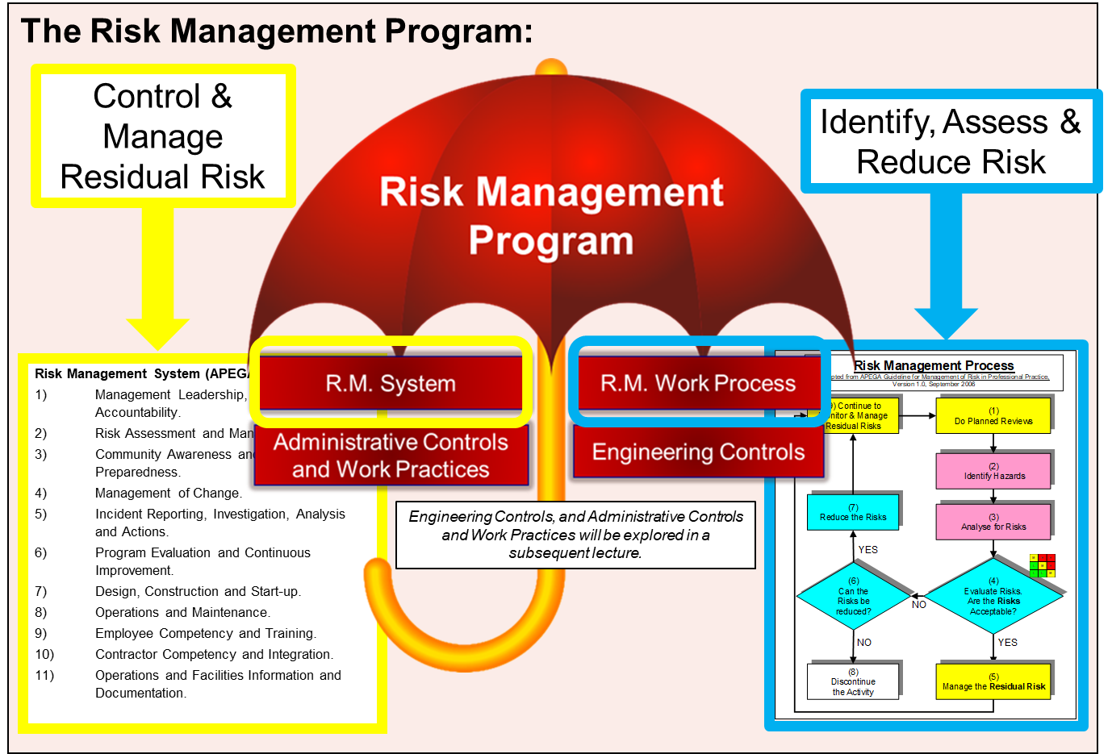
Summary:
The RM Work Process and the RM System Elements are integrated, with purpose to assess and reduce risk, and to manage and control residual risks for different activities.
RM Element #1 is the most important
Chapter 3.1-3.2-3.3: RM Program, Work Process, System, Elements
15
Notes:
15

